Slide 1


Chapter 3
Virtual Local Area Networks
(VLANs)
Part II

Slide 2
Note for Instructors
These presentations are the result of a collaboration among the instructors at St. Clair College in Windsor, Ontario.
Thanks must go out to Rick Graziani of Cabrillo College. His material and additional information was used as a reference in their creation.
If anyone finds any errors or omissions, please let me know at:
  tdame@stclaircollege.ca.

Slide 3
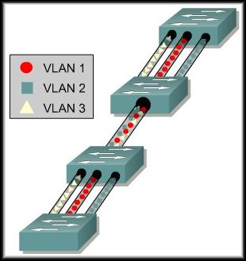
Virtual Local Area Networks
VLAN Trunking

Slide 4
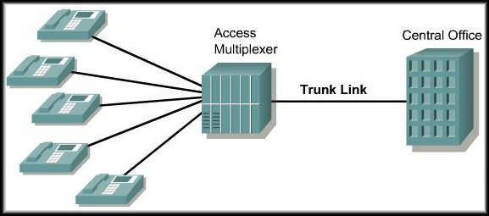
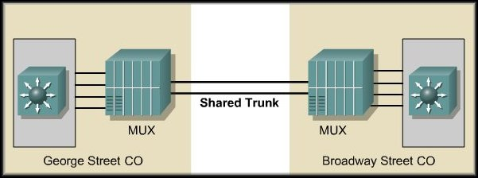
VLAN Trunking
The concept of trunking began with the telephone industry.
Multiple calls were moved between customers and central offices or between the offices themselves over a single physical connection.

Slide 5
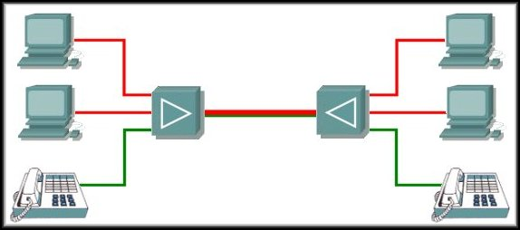
VLAN Trunking
24 Channel T1 Line with Data and Voice
The same principle was applied to data communications to make better use of the communication line.
Additional advantages and cost savings were gained by using the same line for voice communications.

Slide 6
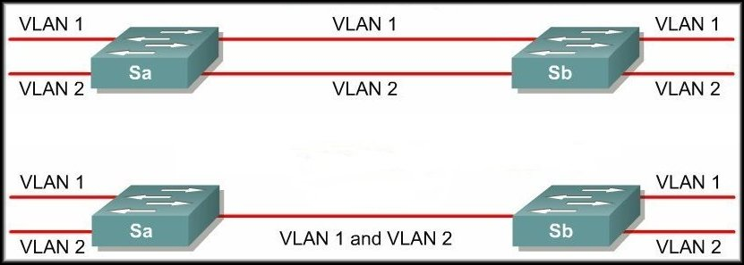
VLAN Trunking
No trunk
Trunk
The same principle of trunking is applied to network switching technologies.
A trunk is a physical and logical connection between two switches across which network traffic travels.

Slide 7
VLAN Trunking
It is also important to
realize that a trunk link
does not belong to a
specific VLAN.
The responsibility of a
trunk link is to act as a
conduit for VLANs.
  Between switches and
  routers.
  Between switches
  and switches.

Slide 8
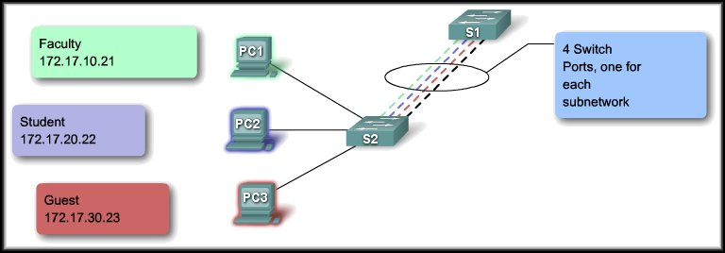
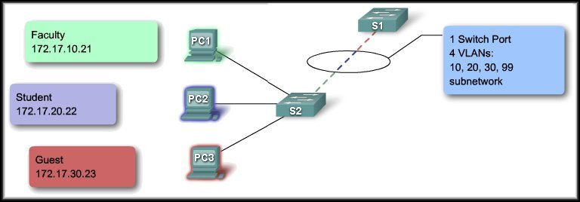
VLAN Trunks
What problem does it solve?
Network 172.17.10.0/24
Network 172.17.20.0/24
Network 172.17.30.0/24
Network 172.17.99.0/24

Slide 9
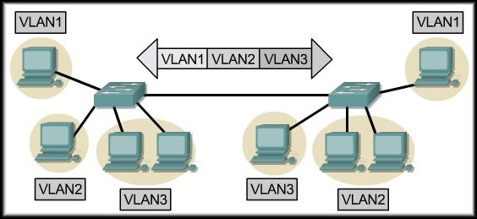
IEEE 802.1Q Frame Tagging
Remember that switches are Layer 2 devices.
  Only use the Ethernet frame header information.
  Frame header does not contain information about VLAN membership.
VLAN membership (i.e. VLAN ID or VLAN Number) must be identified for each frame that is transferred over the trunk.
The process is called 802.1Q VLAN Tagging.

Slide 10
IEEE 802.1Q Frame Tagging
Length 1518 Bytes
6 | 6 | 2 | 1500 | 4
Destination Address | Source Address | Type / Length | Data Max of 1500 Bytes | FCS
Length 1522 Bytes
6 | 6 | 2 | 2 | 2 | 1500 | 4
Destination Address | Source Address | 802.1Q Tag |  | Type/ Length | Data Max of 1500 Bytes | New FCS
 |  | 8100 | Tag

Slide 11
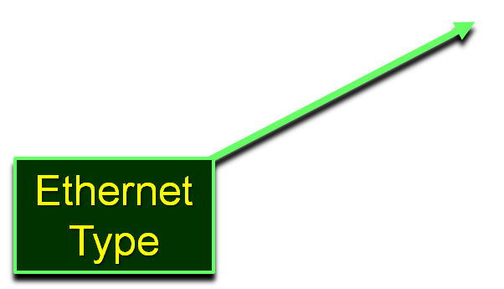
IEEE 802.1Q Frame Tagging
Length 1522 Bytes
6 | 6 | 2 | 2 | 2 | 1500 | 4
Destination Address | Source Address | 802.1Q Tag |  | Type/ Length | Data Max of 1500 Bytes | New FCS
 |  | 8100 | Tag
3 Bits | 1 Bit | 12 Bits
User Priority | CFI | VLAN ID
Canonical Format Identifier

Slide 12
Native VLANs
Tagged Frames on the native VLAN.
  Some devices that support trunking tag native VLAN traffic as a default behavior.
  Control traffic sent on the native VLAN should be untagged.
    If an 802.1Q trunk port receives a tagged frame on the NATIVE VLAN ONLY, it drops the frame.
    When configuring a switch port on a Cisco switch, you need to identify these devices and configure them so that they do not send tagged frames on the native VLAN.
    Devices from other vendors that support tagged frames on the native VLAN include IP phones, servers, routers, and switches.

Slide 13
Native VLANs
Un-Tagged Frames on the native VLAN.
  When a Cisco switch trunk port receives untagged frames it forwards those frames to the native VLAN.
    Default native VLAN is VLAN 1.
  When you configure an 802.1Q trunk port, a
  default Port VLAN ID (PVID) is assigned the value of the native VLAN.
  All untagged traffic coming in or out of the 802.1Q port is forwarded based on the PVID value.

Slide 14
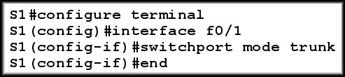
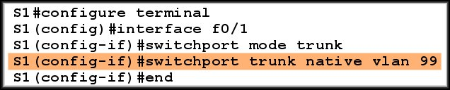
Native VLANs
Configure the trunk to default to native VLAN 1.
Configure the trunk for native VLAN 99.

Slide 15
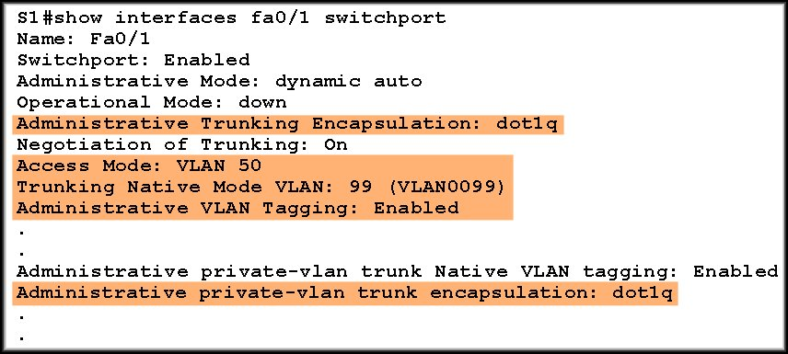
Native VLANs
Verify the configuration.
  VLAN 50 is a voice VLAN.

Slide 16
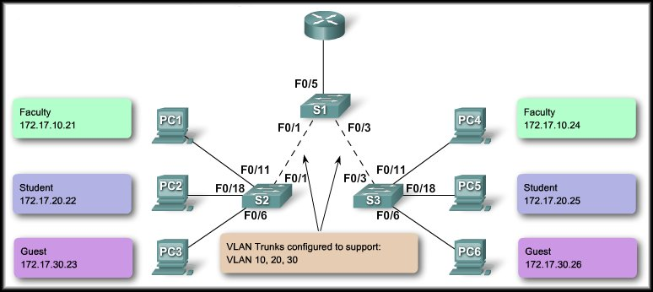
Trunking Operation
The tagged frames are sent across the trunk links between S2 and S1 and S1 and S3.
PC1 and PC3
send a broadcast.
10
10
20
20
30
30
S3 strips the tags and forwards to the destination.
S2 receives the frames and ‘tags’ them with the VLAN ID.

Slide 17
Trunking Modes
A Cisco switch can be configured to support two types of trunk ports:
  IEEE 802.1Q
  ISL (Inter-Switch Link)
Today only 802.1Q is used.
Legacy networks may still use ISL.

Slide 18
Trunking Modes
IEEE 802.1Q:
  Assigned a default PVID.
  Supports simultaneous tagged and untagged traffic.
  Untagged traffic:
    Associated with the port default PVID.
    Null VLAN ID traffic belongs to the default PVID.
  Tagged traffic:
    VLAN ID equal to the outgoing port default PVID is sent untagged.
    Null VLAN ID traffic belongs to the default PVID.
    All other traffic is sent with a VLAN tag.

Slide 19
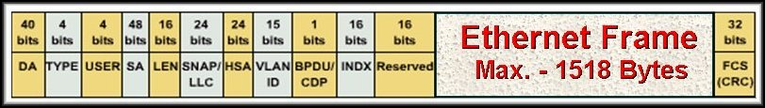
Trunking Modes
ISL (Inter-Switch Link):
  All received packets are expected to be encapsulated with an ISL header.
  All transmitted packets are sent with an ISL header.
  Untagged frames received from an ISL trunk port are dropped.
    No longer recommended or supported.
      30 bytes of overhead for each frame…..

Slide 20
Trunking Modes
Dynamic Trunking Protocol (DTP):
  Cisco proprietary protocol. Switches from other vendors do not support DTP.
  Automatically enabled on a switch port when certain trunking modes are configured on the switch port.
  DTP manages trunk negotiation only if the port on the other switch is configured in a trunk mode that supports DTP.
  DTP supports both ISL and 802.1Q trunks.
  Some Cisco switches and routers (older versions) do not support DTP.

Slide 21
Trunking Modes
Dynamic Trunking Protocol (DTP):
On (default): (switchport mode trunk)
    Periodically sends DTP advertisements, to the remote port that it is dynamically changing to a trunking state.
Dynamic Auto: (switchport mode dynamic auto)
    The switch port periodically sends DTP frames to the remote port. It advertises to the remote switch port that it is able to trunk but does not request to go to the trunking state.
Dynamic Desirable: (switchport mode dynamic desirable)
  DTP frames are sent periodically to the remote port. It advertises to the remote switch port that it is able to trunk and asks the remote switch port to go to the trunking state.

Slide 22
Trunking Modes
Dynamic Trunking Protocol (DTP):
Turn off DTP: (switchport nonegogiate)
    The local port does not send out DTP frames to the remote port.
    The local port is then considered to be in an unconditional trunking state.
    Use this feature when you need to configure a trunk with a switch from another switch vendor.

Slide 23
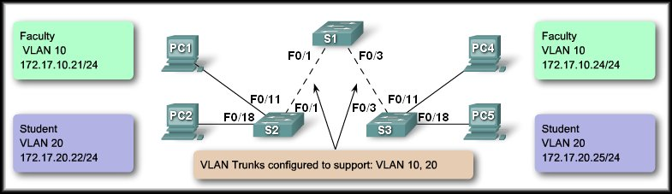
Virtual Local Area Networks
Configure VLANs and Trunks

Slide 24
Configure VLANs and Trunks
Overview:
  Create the VLANs.
  Assign switch ports to VLANs statically.
  Verify VLAN configuration.
  Enable trunking on the inter-switch connections.
  Verify trunk configuration.

Slide 25
Configure a VLAN
Command Syntax:
  S1#configure terminal
  S1(config)#vlan vlan id
  S1(config-vlan)#name vlan name
  S1(config-vlan)#end

Slide 26
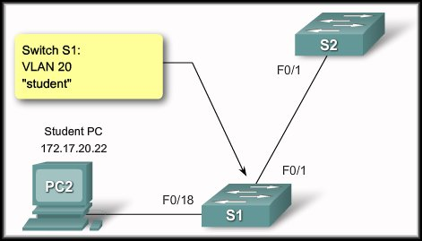
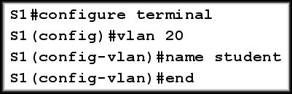
Configure a VLAN
Configure a VLAN

Slide 27
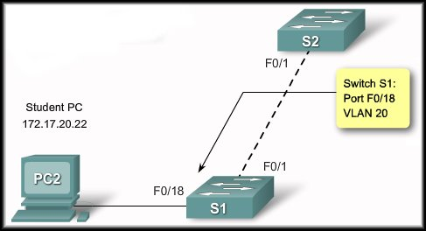
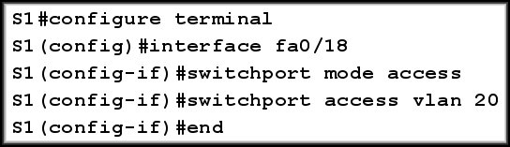
Configure a VLAN
Assign switch ports to a VLAN

Slide 28
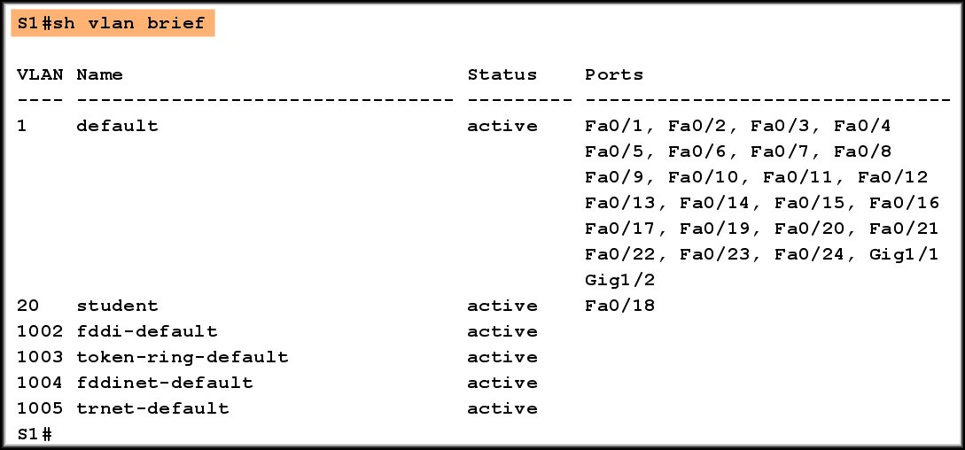
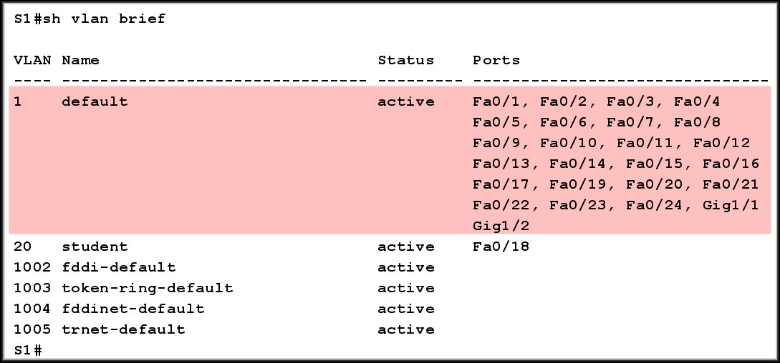
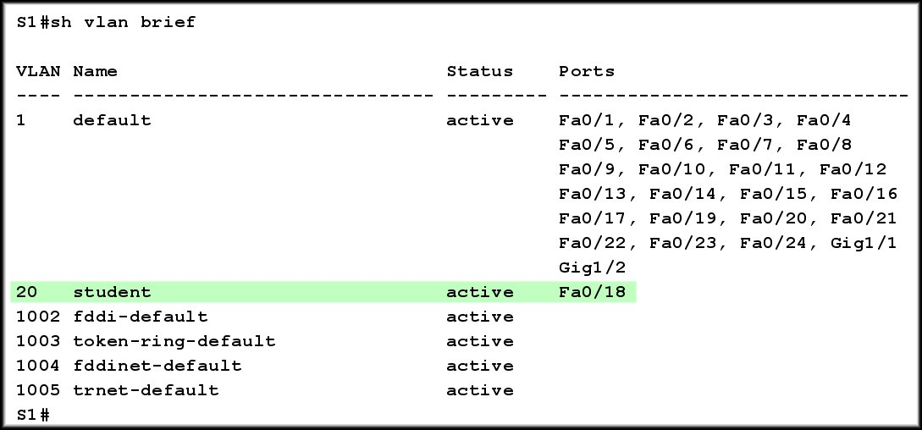
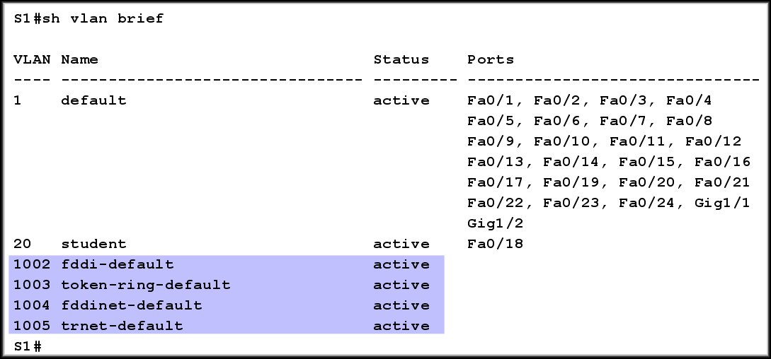
Configure a VLAN
Verify VLAN configuration

Slide 29
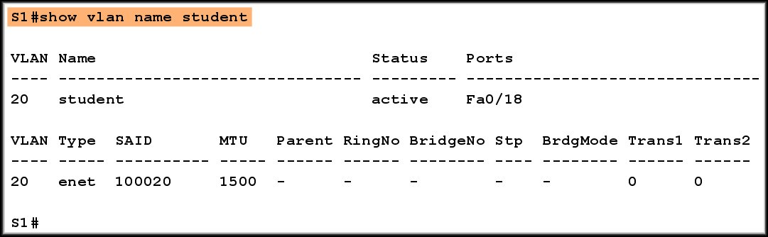
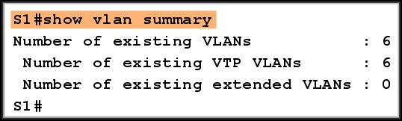
Managing VLANs
Other show vlan command options

Slide 30
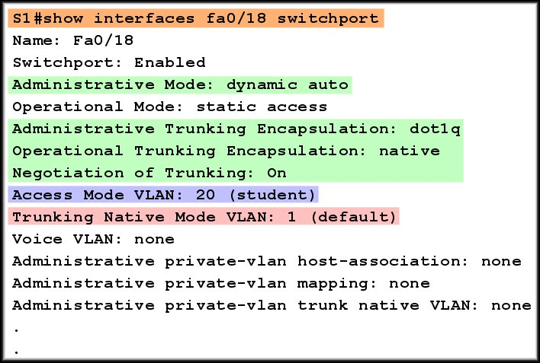
Managing VLANs
show interfaces command

Slide 31

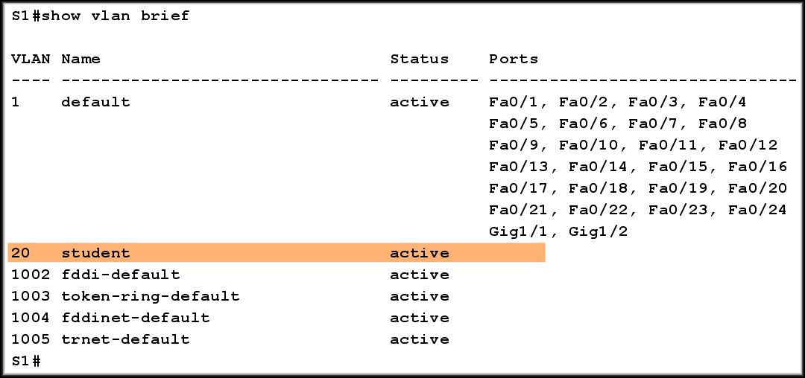
Managing VLANs
Manage VLAN Memberships
Remove port VLAN membership.

Slide 32

Managing VLANs
Manage VLAN Memberships
Remove port VLAN membership.
Remove a VLAN
If you remove the VLAN before removing the port membership assignments, the ports become unusable until you issue the no switchport access vlan command.

Slide 33
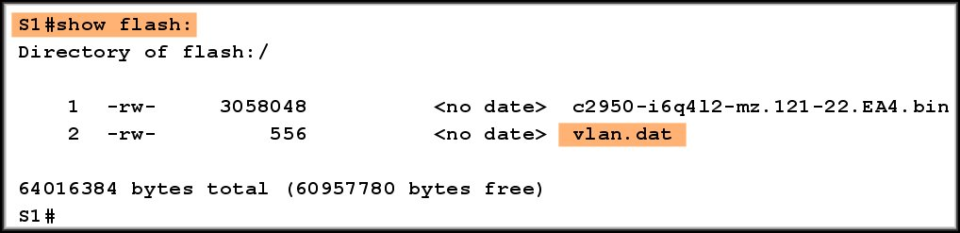
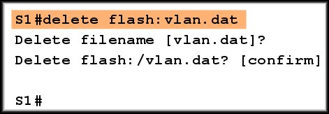
Managing VLANs
Restoring to Factory Defaults:
  To remove all VLAN configuration:
VLAN configuration stored here.

Slide 34
Configure a Trunk
Command Syntax:
  S1#configure terminal
  S1(config)#interface interface-id
  S1(config-if)#switchport mode trunk
  S1(config-if)#switchport trunk native vlan vlan-id
  S1(config-if)#switchport trunk allowed vlan add vlan-list
  S1(config-vlan)#end

Slide 35
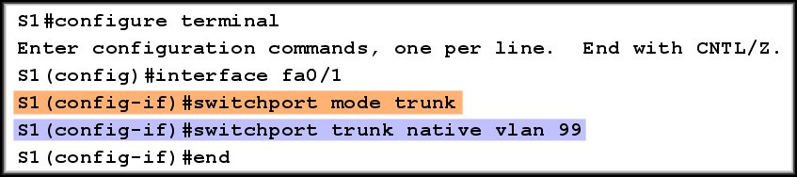
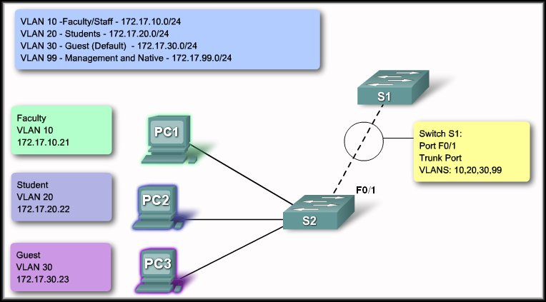
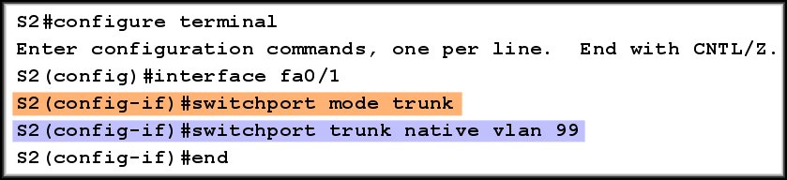
Configure a Trunk

Slide 36
Configure a Trunk
The native VLAN must match on both switches.

Slide 37
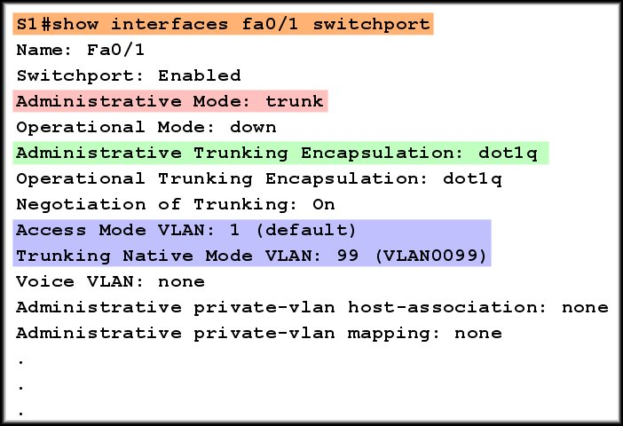
Verify Trunk Configuration

Slide 38
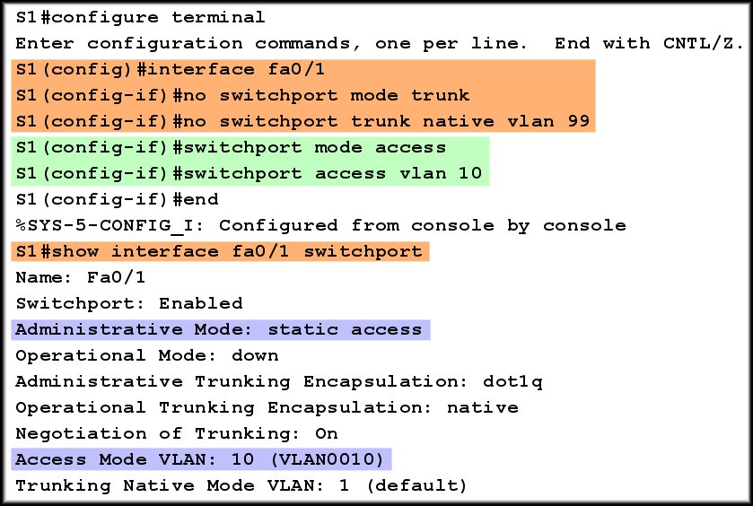
Managing a Trunk Configuration

Slide 39
Managing a Trunk Configuration
Pruning:
  The process of specifying the traffic that will be allowed to traverse the trunk link.
  Use the command:
  switchport trunk allowed vlan add vlan-list
  The vlan-list is a list of the VLAN IDs, separated by commas, that will be allowed to use the trunk link.
  The lists must match on both switches.

Slide 40
Common Problems with Trunks
Native VLAN mismatches:
  Trunk ports are configured with different native VLANs.
Trunk Mode mismatches:
  One trunk port is configured with trunk mode off and the other with trunk mode on.
VLANs and IP Subnets:
  End user devices configured with incorrect IP addresses will not have network connectivity. Each VLAN is a logically separate IP subnetwork. Devices within the VLAN must be configured with the correct IP settings.
Allowed VLANs on trunks:
  The list of allowed VLANs on a trunk does not match on both ends of the trunk.

